Slide 1
11강. Policy Gradient methods

Slide 2
Contents
Policy Gradient
Overview
Advantages
Stochastic policy
Policy performance
Stochastic Gradient Ascent
Policy Gradient Theorem
REINFORCE
Overview
Parallel learning
Exploration strategy
Code Ex. REINFORCE + Parallel Agent Learning
Actor-Critic
Overview
A2C
Overview
Return vs. Advantage
Stochastic Gradient Ascent
REINFORCE vs. A2C
Code Ex.: A2C + Parallel Agent Learning

Slide 3
Policy Gradient methods

Slide 4
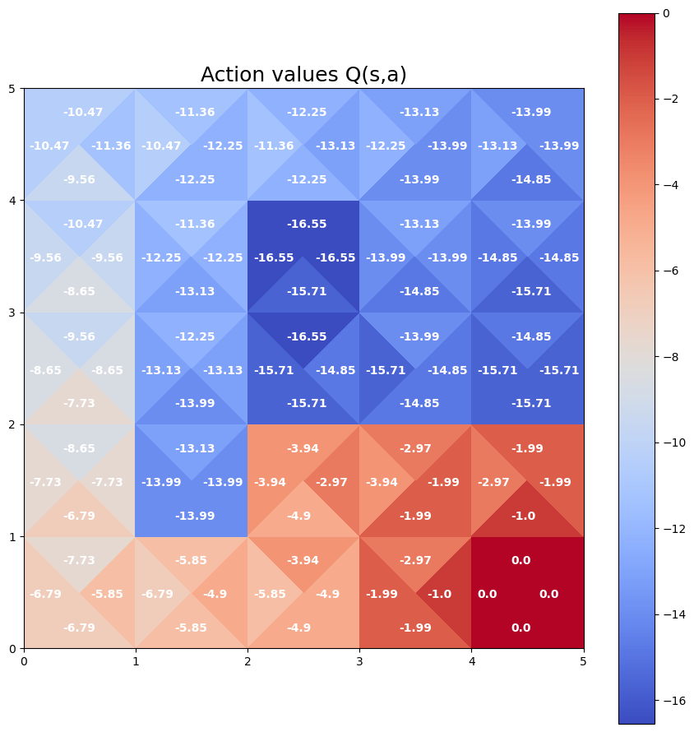
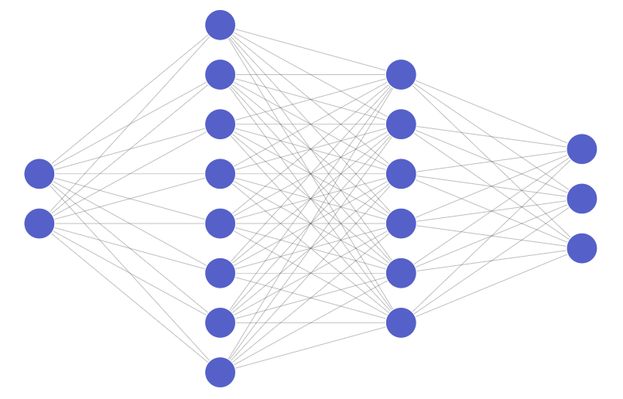
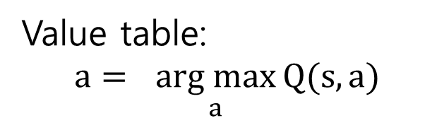

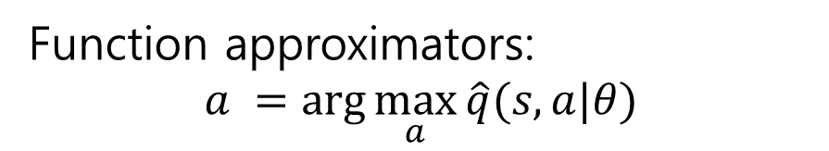
Overview
So far, we learned Q value-based methods, the policy is defined based on Q values
Value table$\text{: }$
$$a= \underset{a}{arg max}{Q(s, a)}$$
Function approximators$\text{:}$
$$a =\arg{\max_{a}{\hat{q}(s,a|θ)}}$$
s,a
$$\hat{q}$$

Slide 5
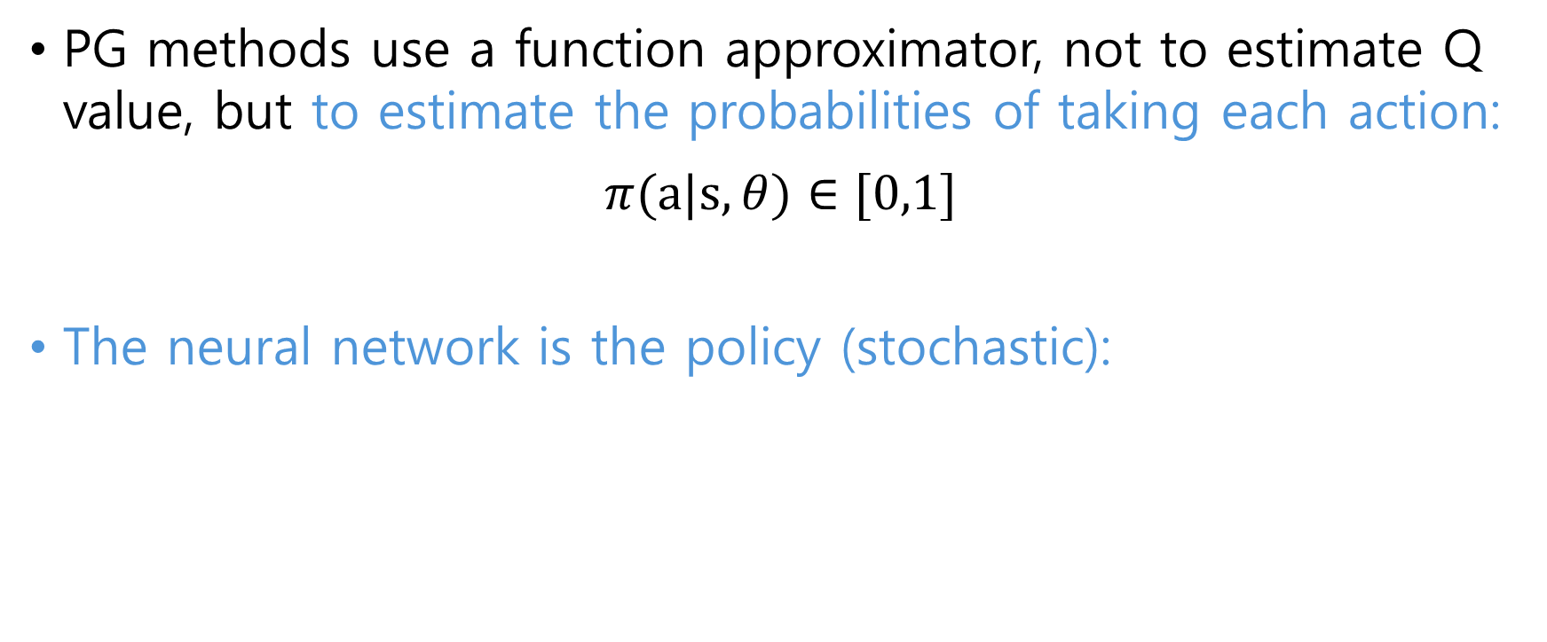
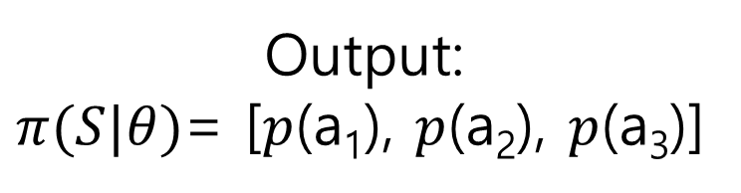
Overview
PG methods use a function approximator, not to estimate Q value, but to estimate the probabilities of taking each action:
$π(a|s, θ)∈[0,1]$
The neural network is the policy (stochastic):
Input:
s=[s₁,s₂]
Output:
$π(S|θ)$= [$p$(a₁), $p$(a₂), $p$(a₃)]

Slide 6
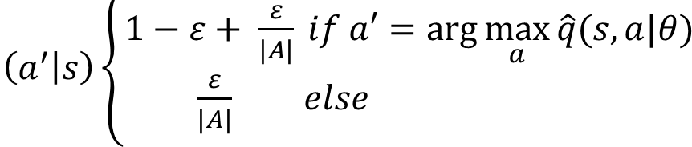
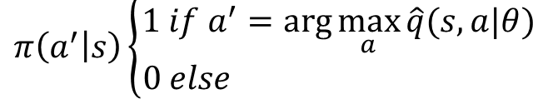
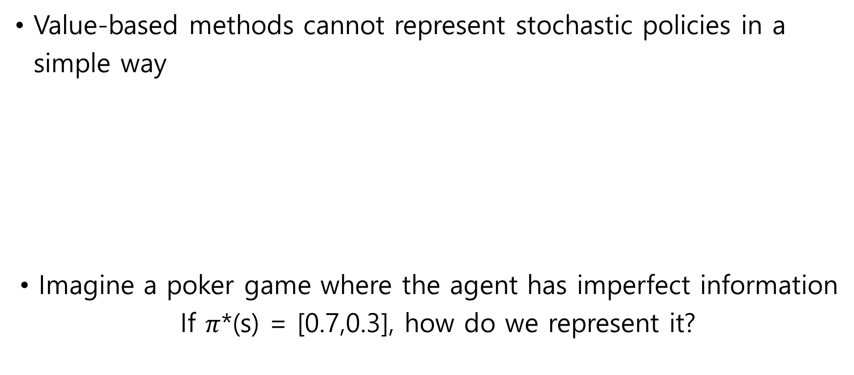
Advantages
Value-based methods cannot represent stochastic policies in a simple way
Imagine a poker game where the agent has imperfect information If $π$*(s) = [0.7,0.3], how do we represent it?
Greedy policy:
Epsilon-greedy policy

Slide 7
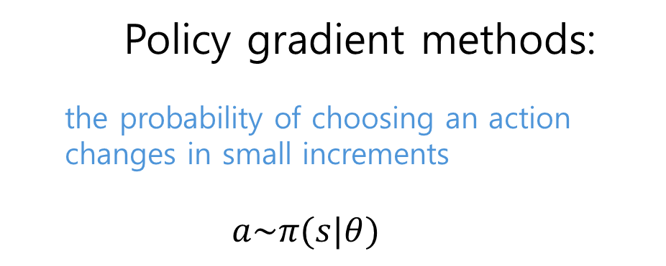
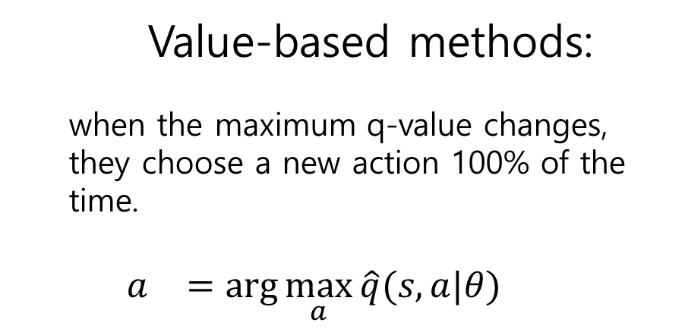
Advantages
The policy changes more smoothly during learning:
Value-based methods:
when the maximum q-value changes, they choose a new action 100% of the time.
$$a^{}=\arg{\max_{a}{\hat{q}(s,a|θ)}}$$
Policy gradient methods:
the probability of choosing an action changes in small increments
$$a\sim π(s|θ)$$
The probabilities of taking an action gradually increase if the action turns out to be effective and gradually decrease if not

Slide 8
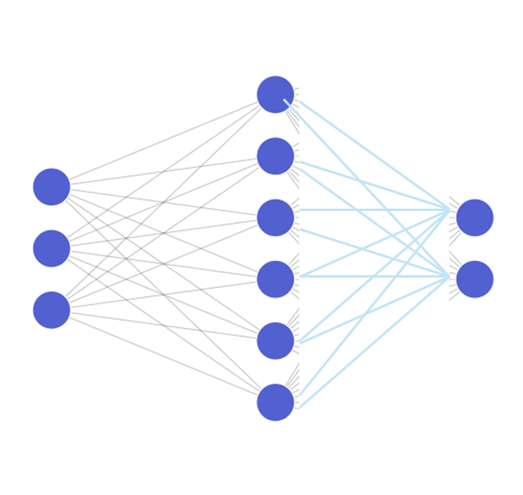
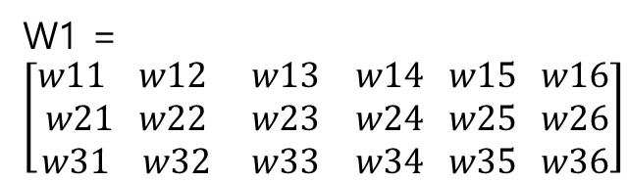
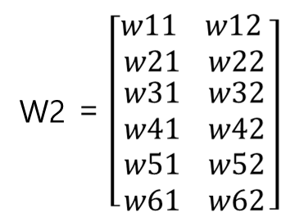
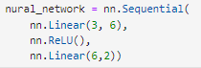
Stochastic policy
The neural network can be viewed as a function:
By changing its parameters W1, we can modify it to approximate the function we are interested in
$$y= φ2(φ1\left(x∙w1\right)∙w2)$$

Slide 9
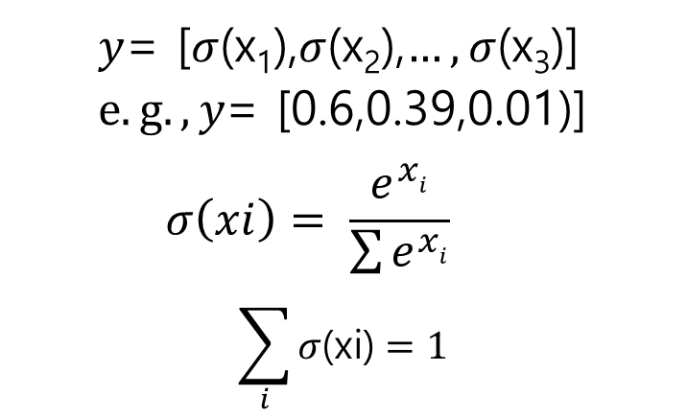
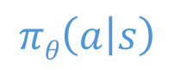
Stochastic policy
By normalizing the neural network’s output, softmax activation function is perfect tool to generate probability vector, y
x=[x₁, x₂]
$$πθ\left(a | s\right)$$

Slide 10
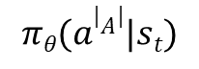
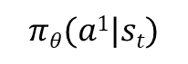
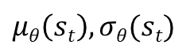
Stochastic policy
Discrete action space:
Continuous action space:
$$πθ(a1|st)$$
NN
s_{t}
$$πθ(a|A||st)$$
NN
s_{t}
$$μθ\left(st\right), σθ(st)$$

Slide 11
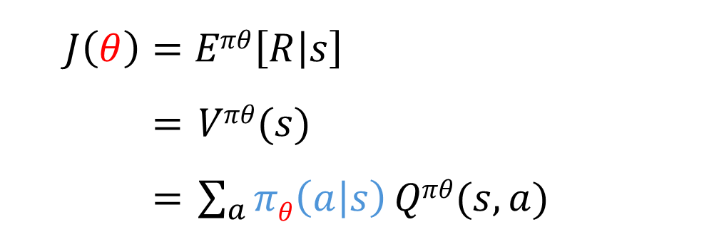
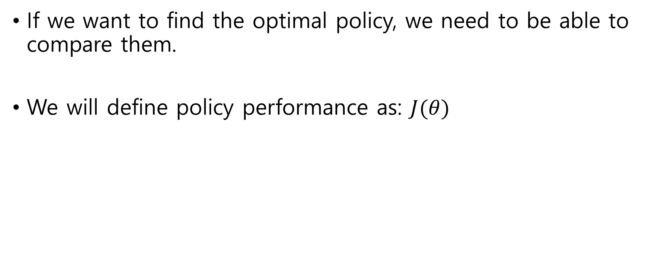
Policy performance
If we want to find the optimal policy, we need to be able to compare them.
We will define policy performance as: $J(θ)$
the performance of the policy is a function of its parameters
$$J\left(θ\right)=Eπθ\left[R | s\right]$$
$=$ $Vπθ(s)$
$=$ $\sum_{a}{πθ\left(a | s\right)}Qπθ(s,a)$
By changing the parameters of the neural net., we change the policy

Slide 12
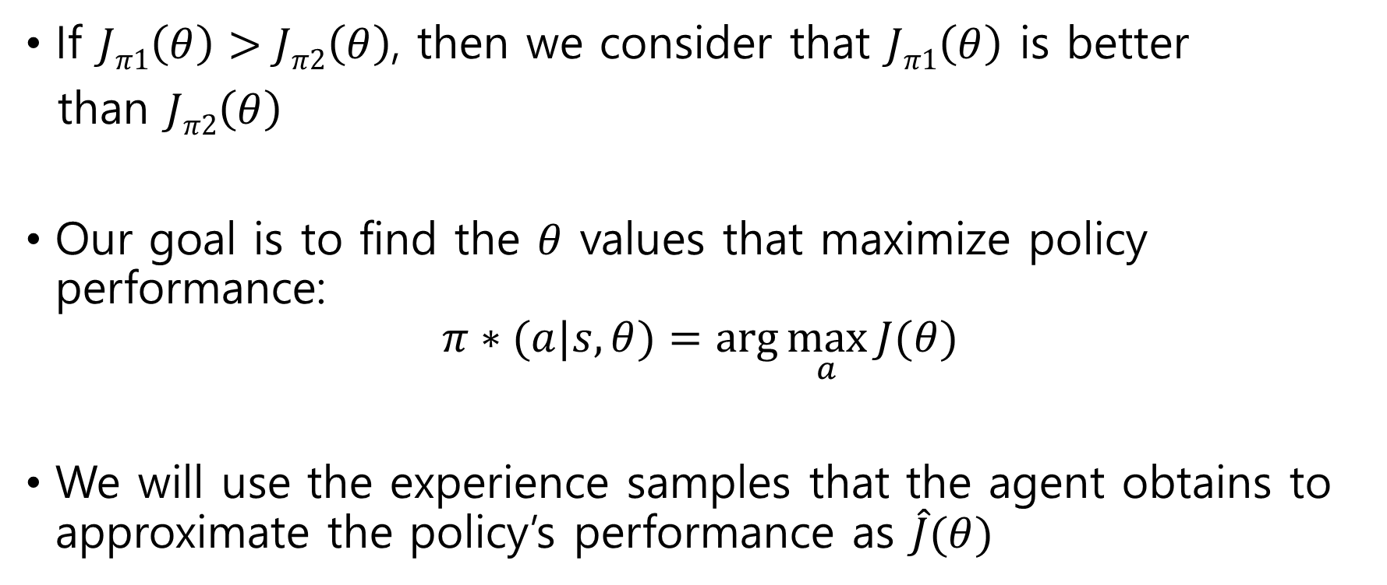
Policy performance
If $Jπ1\left(θ\right)>Jπ2\left(θ\right)$, then we consider that $Jπ1\left(θ\right)$ is better
than $Jπ2\left(θ\right)$
Our goal is to find the $θ$ values that maximize policy performance:
$$π∗(a|s, θ)=\arg{\max_{a}{J(θ)}}$$
We will use the experience samples that the agent obtains to approximate the policy’s performance as $\hat{J}(θ)$

Slide 13
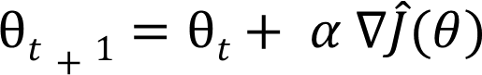
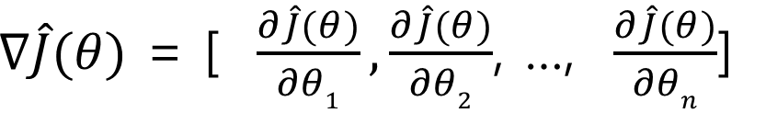
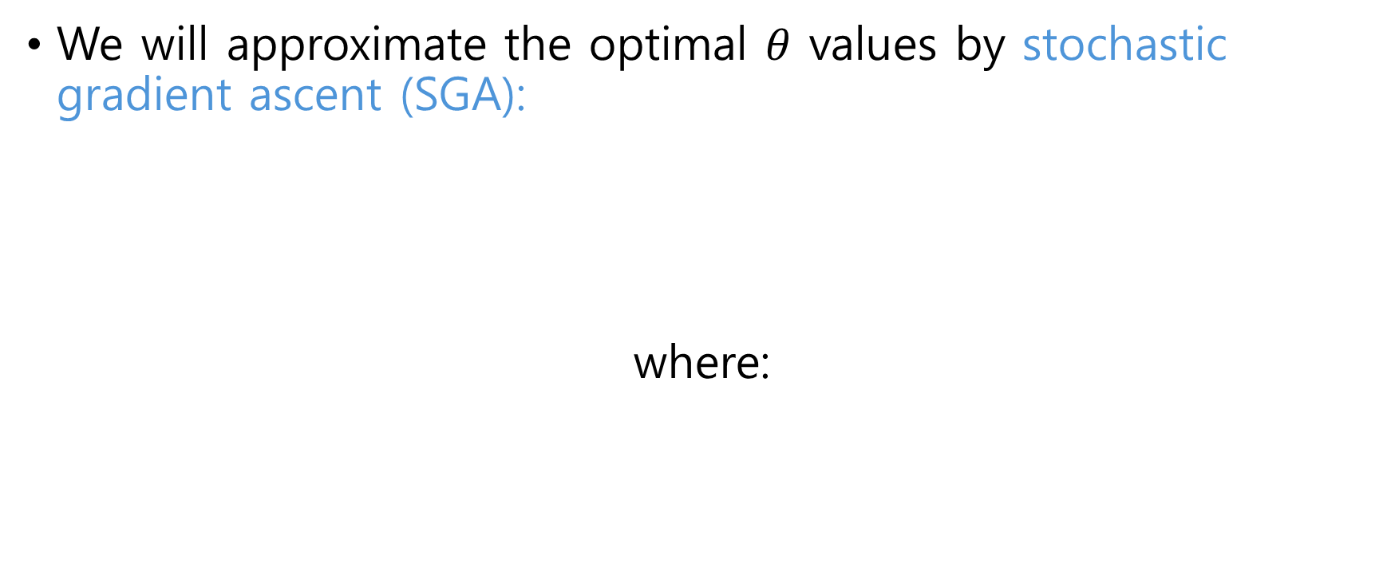
SGA
We will approximate the optimal $θ$ values by stochastic gradient ascent (SGA):
where:
we’ll take the gradient step in the direction of steepest ascent

Slide 14
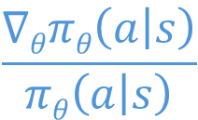
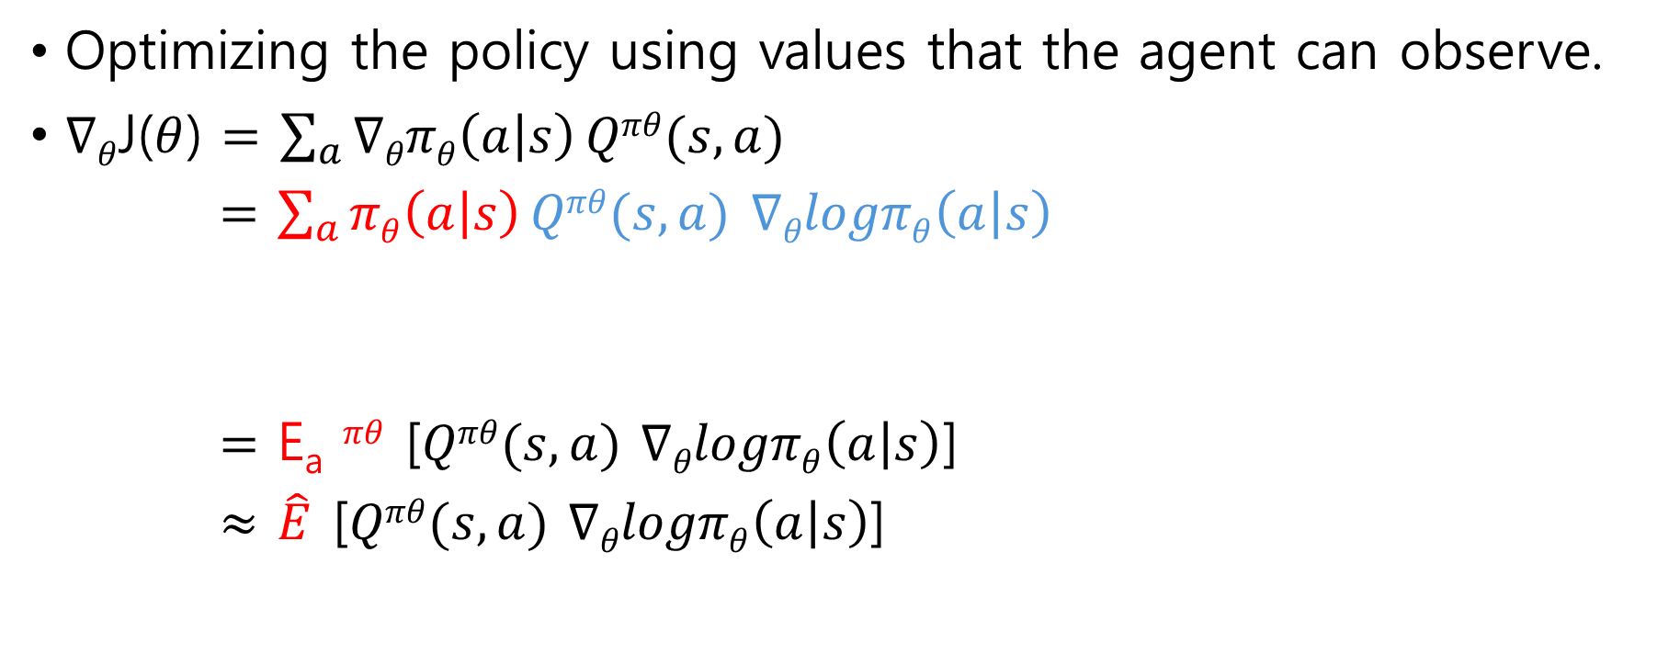
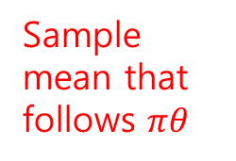
SGA
Optimizing the policy using values that the agent can observe.
$∇θ$J($θ$) $=$ $\sum_{a}{∇θπθ\left(a | s\right)}Qπθ(s,a)$
$=$ $\sum_{a}{πθ\left(a | s\right)}Qπθ(s,a)$ $∇θlogπθ\left(a | s\right)$
$=$ E_{a} $πθ$ [$Qπθ(s,a)$ $∇θlogπθ\left(a | s\right)$]
$≈$ $\hat{E}$ [$Qπθ(s,a)$ $∇θlogπθ\left(a | s\right)$]
Distribution of collected data
$$\frac{∇θπθ\left(a | s\right)}{πθ\left(a | s\right)}$$
Equal to
Sample mean that follows $πθ$

Slide 15
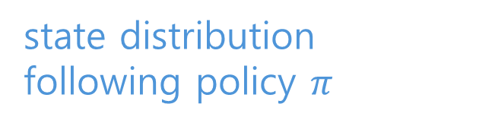
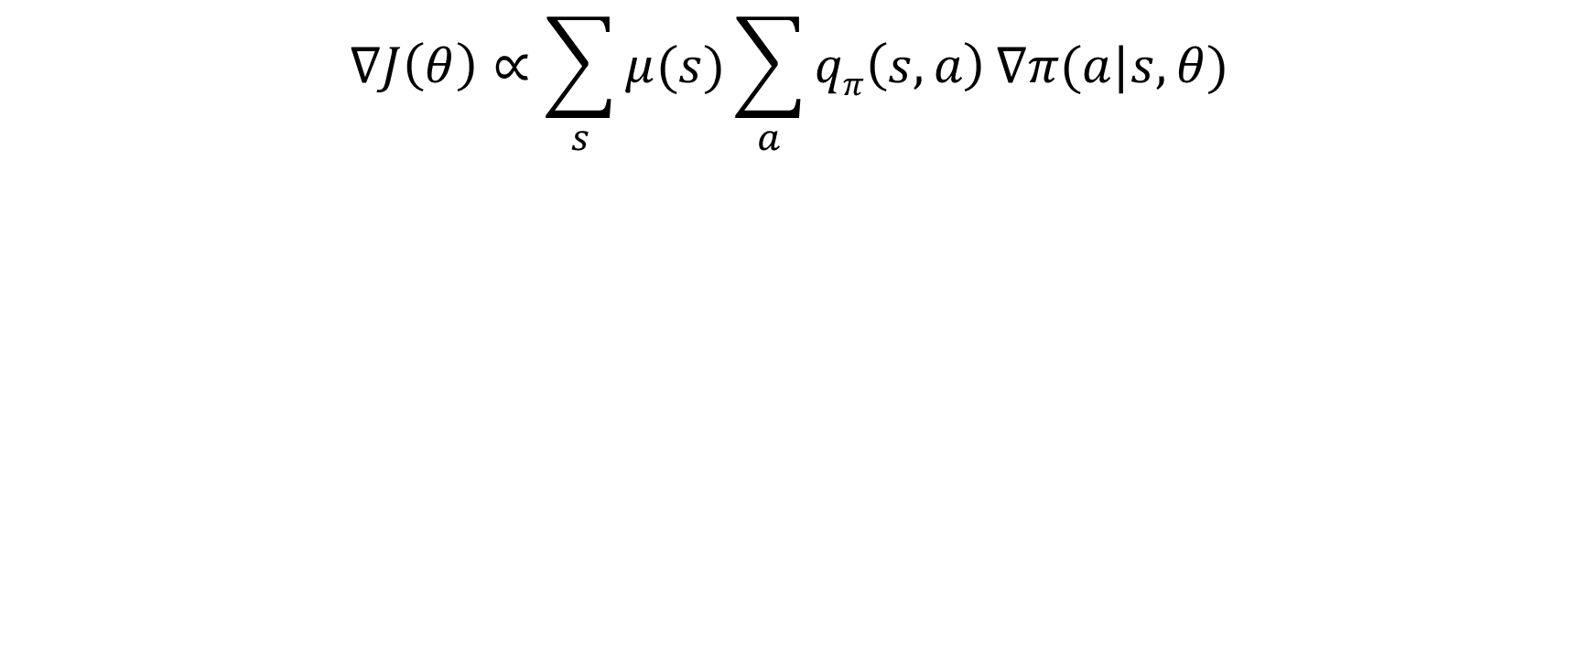
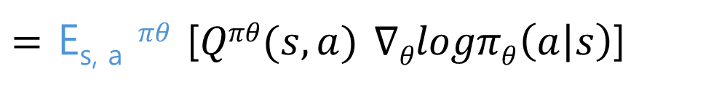
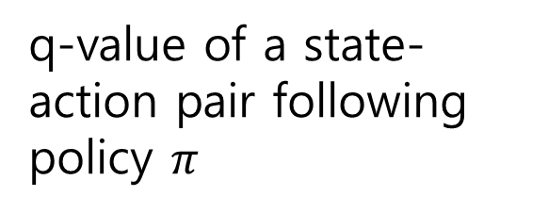
Policy gradient theorem
$$∇J\left(θ\right)∝\sum_{s}{μ(s)}\sum_{a}{qπ\left(s,a\right)}∇π(a|s,θ)$$
Gradient of the probability of selecting action a.
gradient of policy performance
q-value of a state-action pair following policy $π$
state distribution following policy $π$
$=$ E_{s, a} $πθ$ [$Qπθ(s,a)$ $∇θlogπθ\left(a | s\right)$]

Slide 16
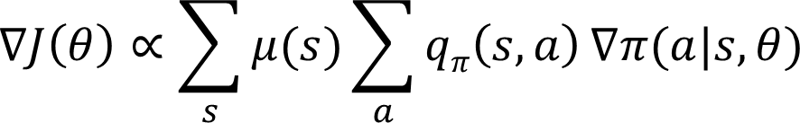
Policy gradient theorem
The PG is,
proportional to the return of each action in each state,
multiplied by the gradient of the probability of taking that action in that state
and weighted by the frequency with which we observe each state following that policy

Slide 17
Policy gradient theorem
If an action in a state produces a positive return, we must increase the probability of picking that action to increase the return.
If that action produces a negative return, the probability of taking that action must be reduced.

Slide 18
REINFORCE

Slide 19
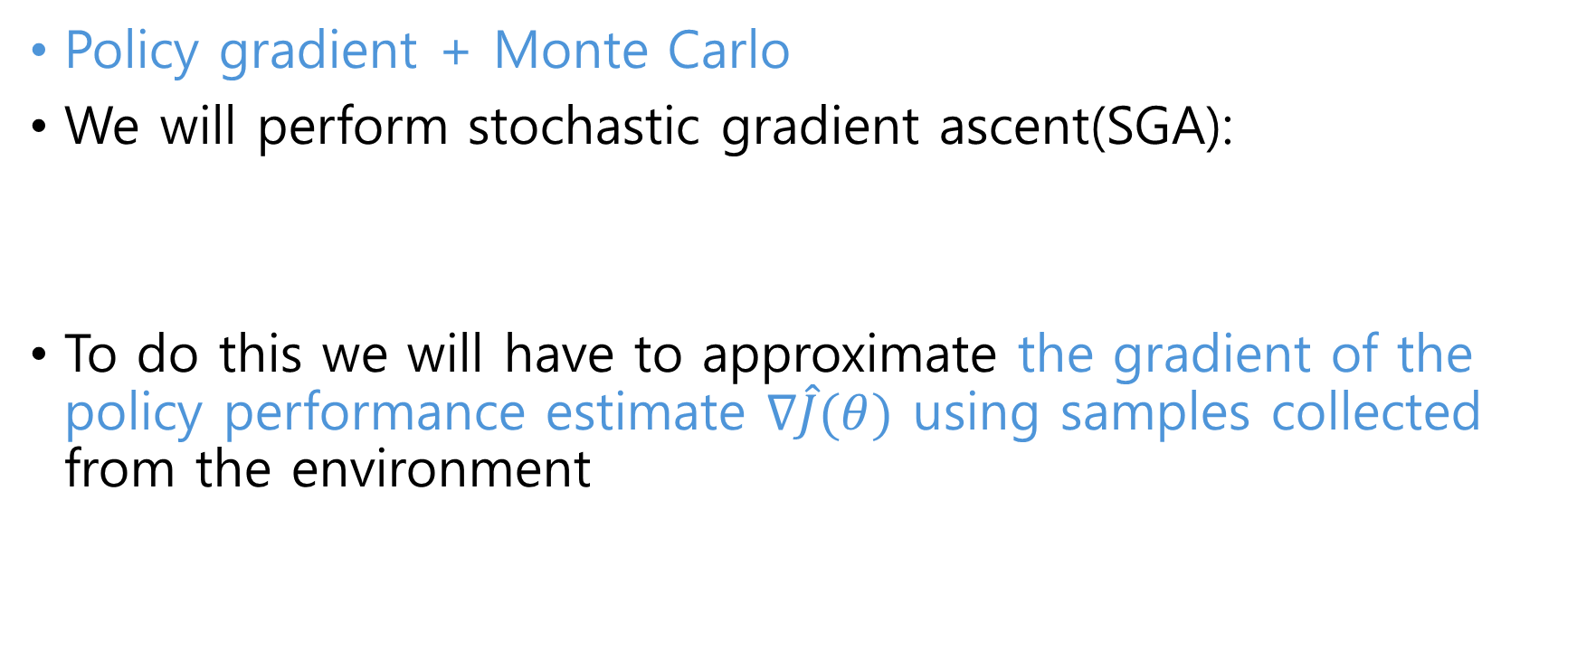
Overview
Policy gradient + Monte Carlo
We will perform stochastic gradient ascent(SGA):
To do this we will have to approximate the gradient of the policy performance estimate $∇\hat{J}(θ)$ using samples collected from the environment

Slide 20
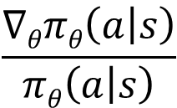
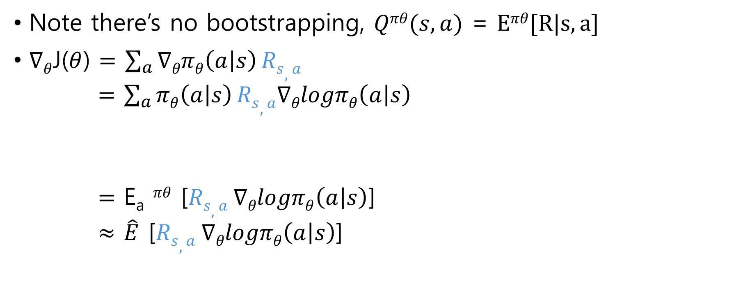
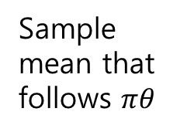
Overview
Note there’s no bootstrapping, $Qπθ(s,a)$ = $Eπθ[R|s,a]$
$∇θ$J($θ$) $=$ $\sum_{a}{∇θπθ\left(a | s\right)}Rs,a$
$=$ $\sum_{a}{πθ\left(a | s\right)}Rs,a∇θlogπθ\left(a | s\right)$
$=$ E_{a} $πθ$ [$Rs,a ∇θlogπθ\left(a | s\right)$]
$≈$ $\hat{E}$ [$Rs,a ∇θlogπθ\left(a | s\right)$]
Distribution of collected data
$$\frac{∇θπθ\left(a | s\right)}{πθ\left(a | s\right)}$$
Equal to
Sample mean that follows $πθ$

Slide 21
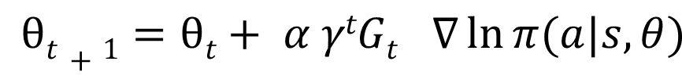
Overview
We will perform stochastic gradient ascent(SGA):
REINFORCE perform stochastic gradient ascent(SGA):

Slide 22
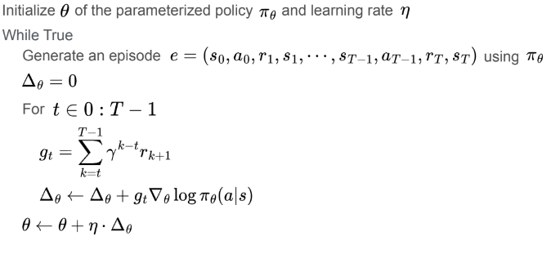
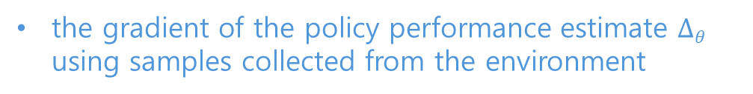
Overview
Get an episode
g_{t} is the actual return obtained starting at time t of the episode(all the rewards obtained until the end of the episode)
the gradient of the policy performance estimate $∆θ$ using samples collected from the environment
Stochastic gradient ascent:

Slide 23
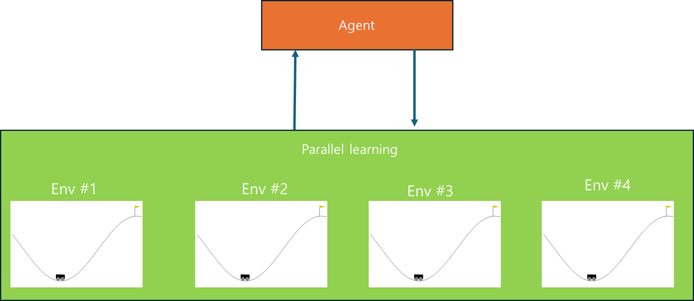
Parallel learning
Successive state tend to be very be very similar to the previous one, and this is called the time correlation problem
The solution used with Policy Gradient methods

Slide 24
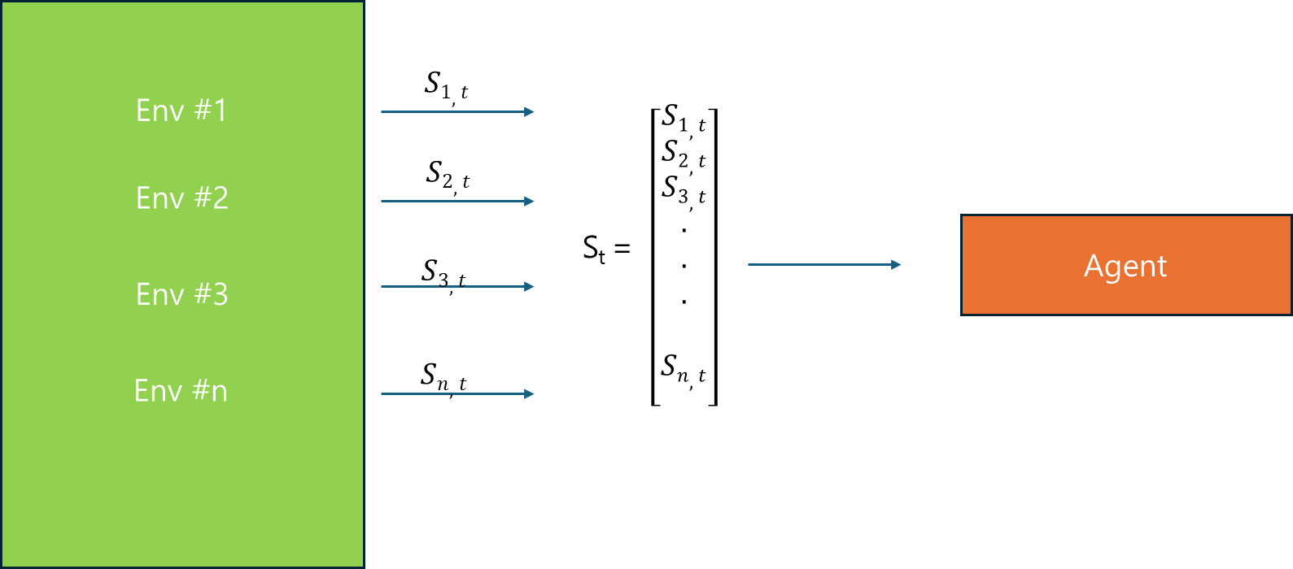
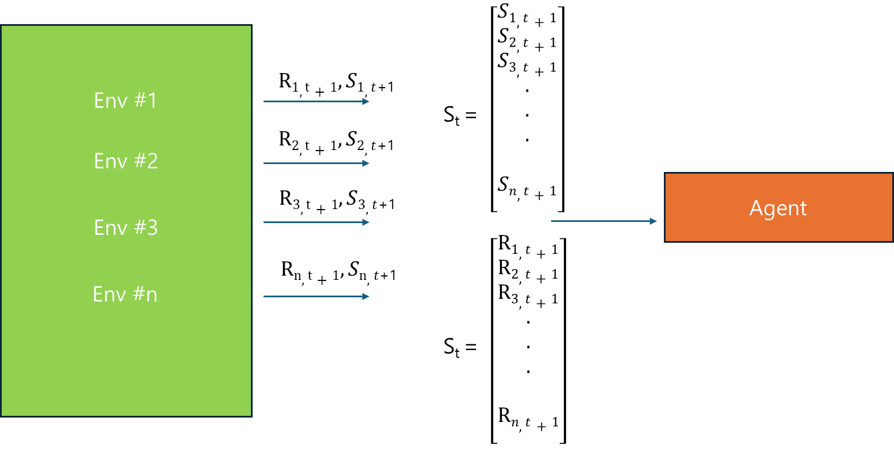
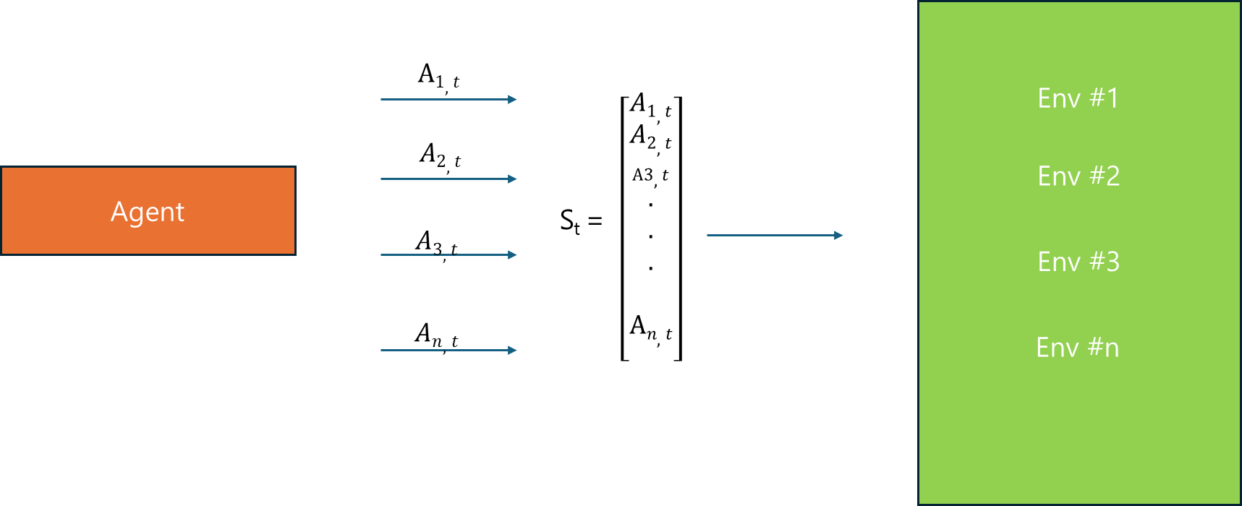
Parallel learning

Slide 25
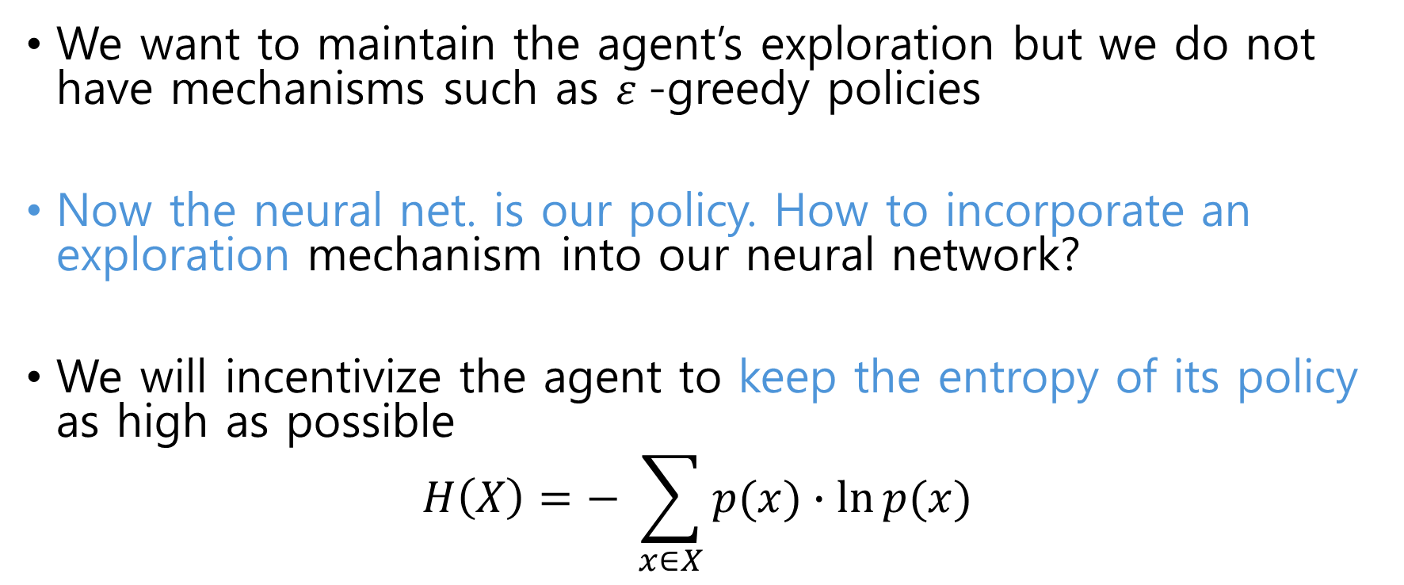
Exploration Strategy
We want to maintain the agent’s exploration but we do not have mechanisms such as $ε$-greedy policies
Now the neural net. is our policy. How to incorporate an exploration mechanism into our neural network?
We will incentivize the agent to keep the entropy of its policy as high as possible
$$H\left(X\right)=− \sum_{x∈X}{p(x)∙\ln{p(x)}}$$

Slide 26
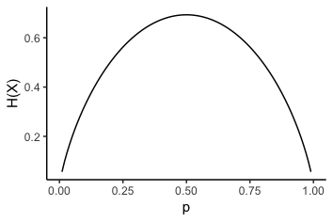
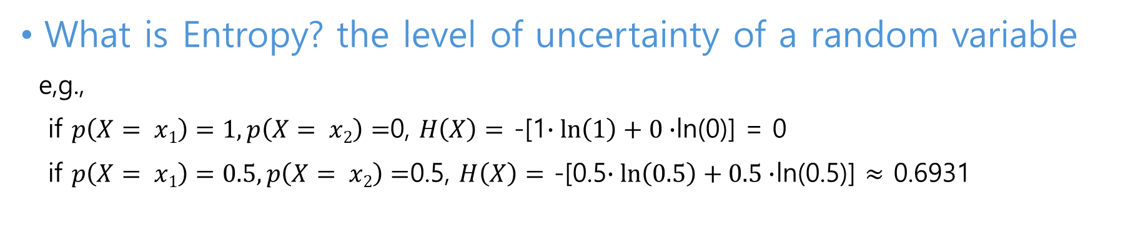
Exploration Strategy
What is Entropy? the level of uncertainty of a random variable
e,g.,
if $p\left(X= x1\right)=1,p\left(X= x2\right)=$0, $H\left(X\right)=$ -[1$∙\ln\left(1\right)+0∙$ln(0)] = 0
if $p\left(X= x1\right)=0.5,p\left(X= x2\right)=$0.5, $H\left(X\right)=$ -[0.5$∙\ln\left(0.5\right)+0.5∙$ln(0.5)] $≈$ 0.6931
Max. point where our confidence in our predictions will go down.
Max. point where it surprises us

Slide 27
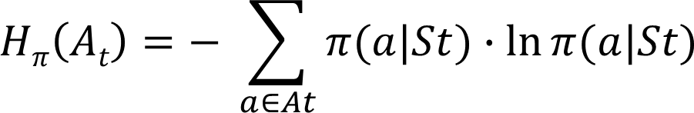
Exploration Strategy
What is the entropy of a policy?
Uncertainty in the action to be selected in a state:
Random variable(A_{t}) is the action the policy will choose in a state.
The entropy is computed by multiplying the probability of choosing each action by its logarithm and adding up the results

Slide 28
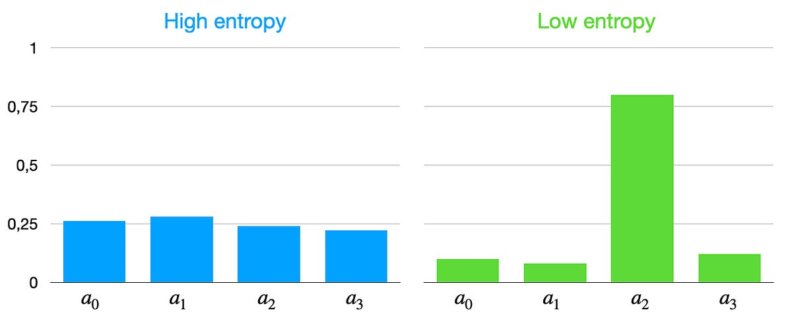
Exploration Strategy
What is the entropy of a policy?
Imagine that we have 4 actions available

Slide 29
Exploration Strategy
What is the entropy of a policy?
In order for the agent to explore the environment. We must keep the entropy of the policy high
We add the entropy to the function to be maximized:
Advantages in optimizing a policy:
Exploration, Robustness, Policy refinement

Slide 30

Parallel REINFORCE learning
We also try to maximize the entropy of the policy

Slide 31

Code Ex.
Upload ‘REINFORCE_CartPole.ipynb’ file onto Colab
Upload ‘utils.py’ file onto Colab
Upload ‘parallel_env.py’ file onto Colab
Add ‘pip install numpy==1.23.1

Slide 32
Code Ex.
Cartpole: move a cart (black) such that it balances a pendulum (brown) without moving too far from the center.
State: The agent observes current position and velocity of the cart, as well as angle and velocity of the pole (cart position, cart velocity, pole angle, pole angular velocity)
Action: It can act by pushing the cart to the left (value 0) or to the right (value 1).
Reward:+1 for every step

Slide 33
Actor-Critic

Slide 34

Overview
‘Monte-Carlo’ Policy Gradient method
J($θ$) $=$ $\sum_{a}{πθ\left(a | s\right)Rs,a }$
‘Actor-Critic’ method requires Q or V to calculate PG
J($θ$) $=$ $\sum_{a}{πθ\left(a | s\right)}Qπθ(s,a)$
$\text{J}\text{(}θ\text{) }=\sum_{s′}{ }\sum_{a}{p\left(s^{′} | s,a\right) πθ\left(a | s\right)}[r+γ$V$πθ(s)]$

Slide 35


Overview
TD + Policy Gradient
Optimize the neural network during the episode by bootstrapping the value of the next state
Recall Temporal Difference (TD) learn at each time step
Agent has both actor and critic networks
$$Q$$
$$π$$

Slide 36
Advantage Actor-Critic(A2C)

Slide 37



Overview
Advantage Actor-Critic
$\hat{A}dvπ$(s,a)
$π$(a |s, $θ)$
$\hat{v}$(s | $ω)$

Slide 38

Overview
Excess return of choosing the $a$ action instead of following the policy:
$Advπ$(s,a) = q $π$(s, a) - v $π$(s)
$Advπ$(s,a) = q $π$(s, a) - $\sum_{a}{π(a|s)qπ(s,a)}$
We want to reinforce the actions that obtain better results and discourage those that obtain worse results

Slide 39



Overview
$Advπ$(s,a) = q $π$(s, a) - v $π$(s)
We can estimate the advantage of an action as:
$\hat{A}dvπ$(s,a) = r(s, a) + $γ\hat{\text{v}}π$(s’) - $\hat{\text{v}}π$(s)
$Advπ$(s,a) > 0 :
Taking the action, a is better than simply following the policy
$Advπ$(s,a) < 0:
Taking the action a is worse than following the policy

Slide 40

Update rule: REINFORCE
Assume agent gets -1 reward each time spent
REINFORCE:
If G_{t} < 0, discourages the actions that will have negative return
If an action led to a negative return, that action was disincentivized even if it was the least bad action available
Eventually it gets to the best policy, but a long time to get there
Using the return, the agent was not able to make these distinctions
The best is -1

Slide 41



Update rule: A2C
A2C:
If $\hat{A}dv$_{t}>0, reinforces the actions that are better
In a bad state, the advantage function helps the agent understand which action is the lesser evil and helps it to reinforce that action
If action, $↓$ is lesser evil, Adv(s, $↓)$ is positive
It also allows it to see which action is the worst in a very good state and disincentivize it
Adv(s, $↓)$

Slide 42

SGA
Where the advantage is the temporal difference error
Bootstrapped value. We don’t need to the end of episode to update the NN
Bootstrapped value: the estimate of the rest of the rewards that we expect to get starting from the next state
The baseline eliminates the effect of the state that we’re in.
Subtract this because we want to evaluate only the merit of that action

Slide 43


REINFORCE vs. A2C
REINFORCE:
Used true return:
Unbiased empirical return, but with high variance
A2C:
Used bootstrapping:
Learning occurs during the episode
we don’t need to the end of episode to update the NN.
Reducing variance accelerates learning
Bootstrapping introduces bias but reduces variance

Slide 44


$$H\left(X\right)=− \sum_{x∈X}{p(x)∙\ln{p(x)}}$$

Slide 45



Code Ex.
Arcrobot: swing the lower part of a two-link robot up to a given height.
Observations space: The agent observes current positions and velocities of the joints.
Action space: It can act by applying positive torque (value 0), no torque (value 1), or negative torque (value 2) only to the joint between the two links.

Slide 46

Code Ex.
Upload ‘A2C_Acrobot.ipynb’ file onto Colab
Upload ‘utils.py’ file onto Colab
Upload ‘parallel_env.py’ file onto Colab
Add ‘pip install numpy==1.23.1

